Slide 1
Delhi Metro Data Analysis Project
Data Cleaning & Visualization | Python |Pandas | Matplotlib |NumPy| Seaborn

Slide 2
Project Overview
2
Conduct a comprehensive analysis of the Delhi Metro trip dataset.
Examine ridership trends, fare structures, station activity, and revenue patterns.
Perform data preprocessing, including handling missing values and ensuring data quality.
Visualize key insights and trends using Matplotlib and Seaborn to support data-driven conclusions.

Slide 3
Dataset Overview
3
The dataset includes the following key columns: From_Station, To_Station, Fare, Distance_km, Passengers, Ticket_Type, Remarks, Date, and Profit.
Performed an initial assessment using functions such as df.head(), df.info(),and df.shape() to understand structure and data types.
Converted the ‘Date’ column to a proper datetime format to enable accurate time-based analysis.

Slide 4
Missing Values & Cleaning Steps
4
Conducted an assessment of missing values using df.isnull().sum().
Imputed missing values in Ticket_Type using the mode.
Imputed missing values in Passengers using the median.
Imputed missing values in Remarks using the mode.
Removed leading and trailing whitespace from station names.

Slide 5
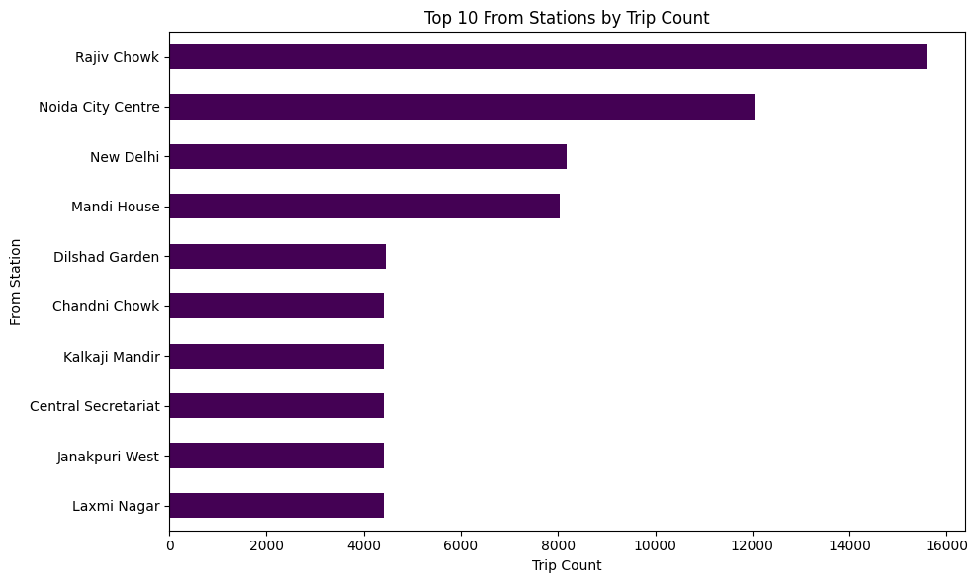
Top 10 From Stations By Trip Count– Insights :
5

Slide 6
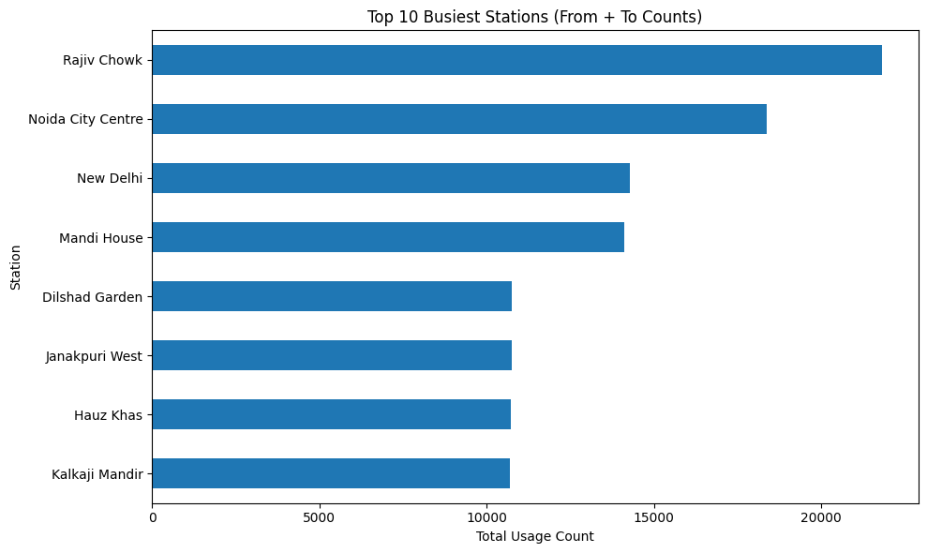
Most Busiest Stations
6

Slide 7
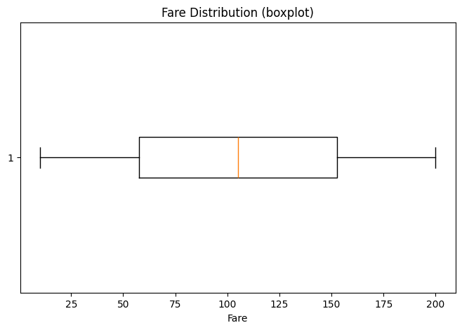
Fare Distribution – Insights:
Show Fare Range & Outliers
7

Slide 8
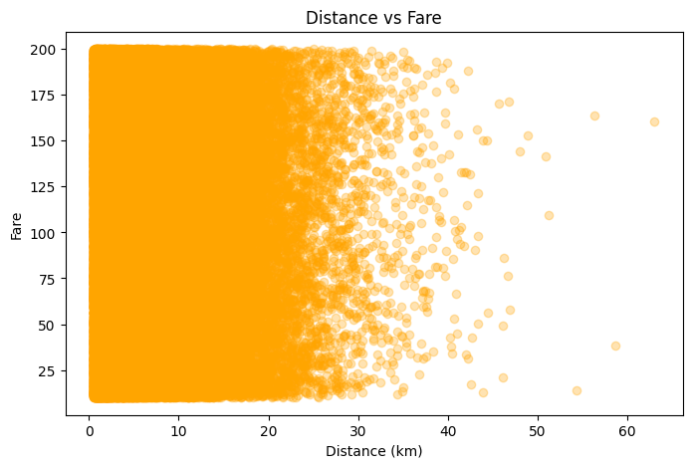
Distance vs Fare – Insights:
8

Slide 9
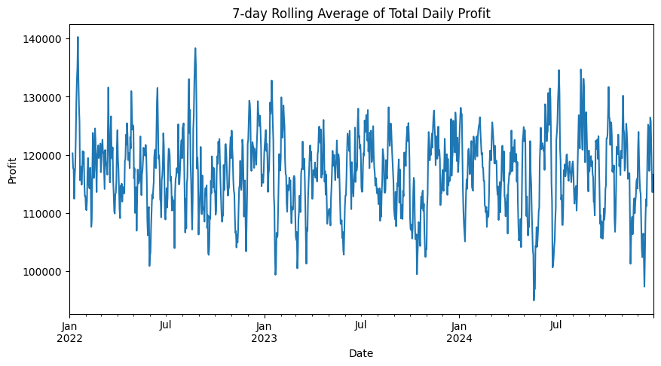
7-Day Rolling Average Of Total Daily Profit :
9

Slide 10
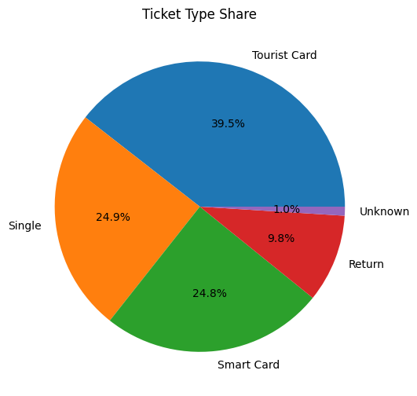
Ticket Type Share
10

Slide 11
Conclusion
11
Data cleaned using mode and median.
Identified busiest stations and high-demand areas.
Clear link found between distance and fare.
Profit trends mostly stable with periodic changes.
Visual analysis improved understanding of commuter and revenue patterns.

Slide 12
Thank You
Irshad Ansari
+91 8528060397
irshadansari19061999@gmail.com

